Slide 1
Data Storage Structures
— Chapter 13
2021年11月
叶文
yewen@bupt.edu.cn
School of Computer Science (National Pilot Software Engineering School)

Slide 2
Introduction to Chapter 13 and Chapter 14
In view of physical DB, two issues should be addressed
data organization in DBS, i.e. physical storage structure of data — Chapter13
data access in DBS — Chapter14
目标
1. 开发数据库应用系统时，根据DBMS提供的机制，选择合适的数据库物理结构，e.g. 分区，分库分表
2. 在数据库表上合理设置索引，提高数据查询速度
实验？. 数据库物理设计：
观察、设计/选择DB文件；设计、使用、比较索引；定长/变长数据类型；分区，分库/分表，集群

Slide 3
Outline
File Organization
Organization of Records in Files
Data-Dictionary Storage
Data Buffer
Column-oriented Storage
Storage Organization in Main-memory

Slide 4
13.2 File Organization
文件逻辑/物理组织 in Operating System Concepts
逻辑结构：
流式文件
基于记录文件
基于索引的文件（按内容访问）
物理结构
以block为单位，进行存储
contiguous, linked, indexed

Slide 5
File Organization
A database is stored as a collection of DB files
SQL Server： 主文件，辅文件，日志文件
Each file is a sequence of records, and a record is a sequence of fields
One approach
assume the record size is fixed
each file has records of one particular type only
different files are used for different relations
this case is easiest to implement; will consider variable length records later
Each file is a sequence of records, and a relational table is a set of tuples，以元组为单位的DB逻辑文件在以记录为单位的OS物理文件中如何实现
A tuple is stored as a record in the DB file
How to represent the tuple as the record in files?
fixed-length records
variable-length records
e.g. name varchar(20)

Slide 6
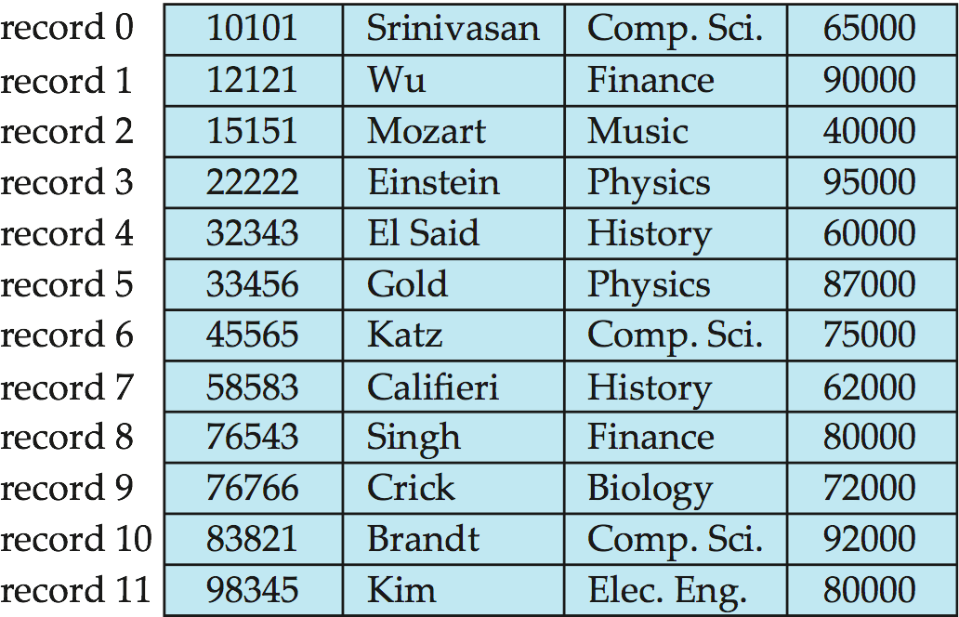
Fixed-Length Records
Simple approach
a block contains several records
store record i starting from byte n ∗ (i – 1), where n is the size of each record.
record access is simple but records may cross blocks
modification:
do not allow records to cross block boundaries
instructor(ID, name, dept, salary)
all records are stored in a contiguous space

Slide 7
Fixed-Length Records
Deletion of record i: alternatives:
compacting: move records i + 1, . . ., n to i, . . . , n – 1
move record n to i
do not move records, but link all free records on a free list
all records are stored in a contiguous space

Slide 8
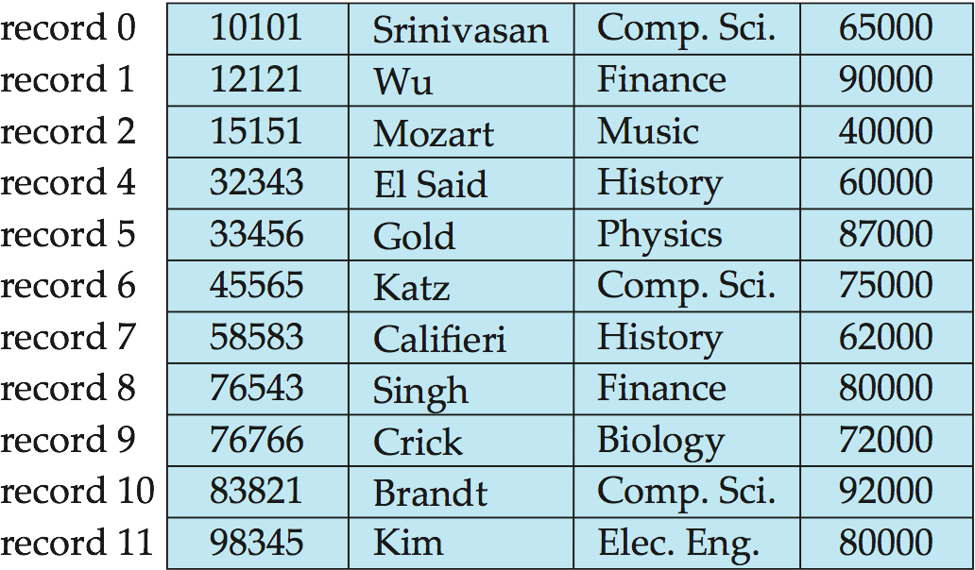
Fixed-Length Records
Deleting record 3 and compacting

Slide 9
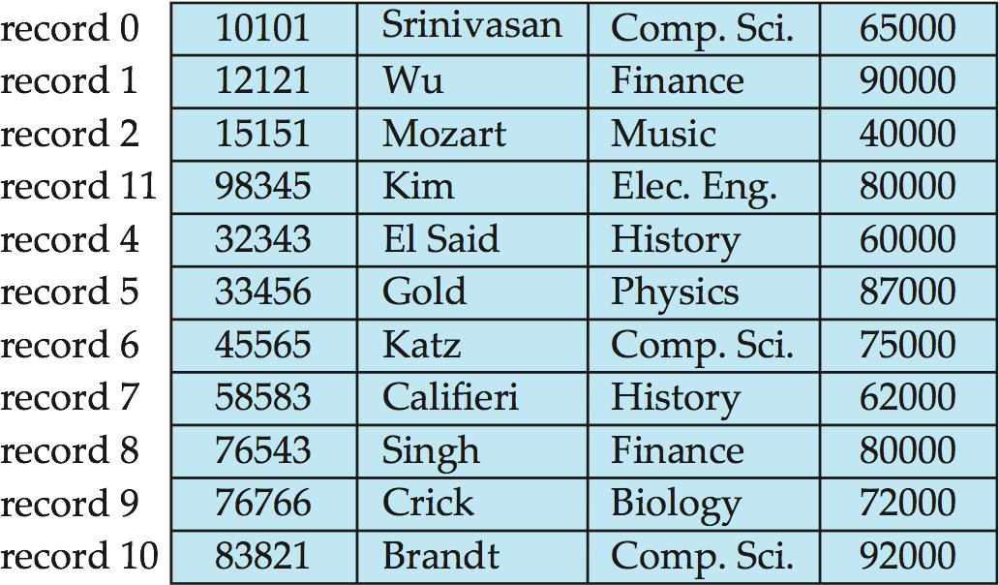
Fixed-Length Records
Deleting record 3 and moving last record

Slide 10
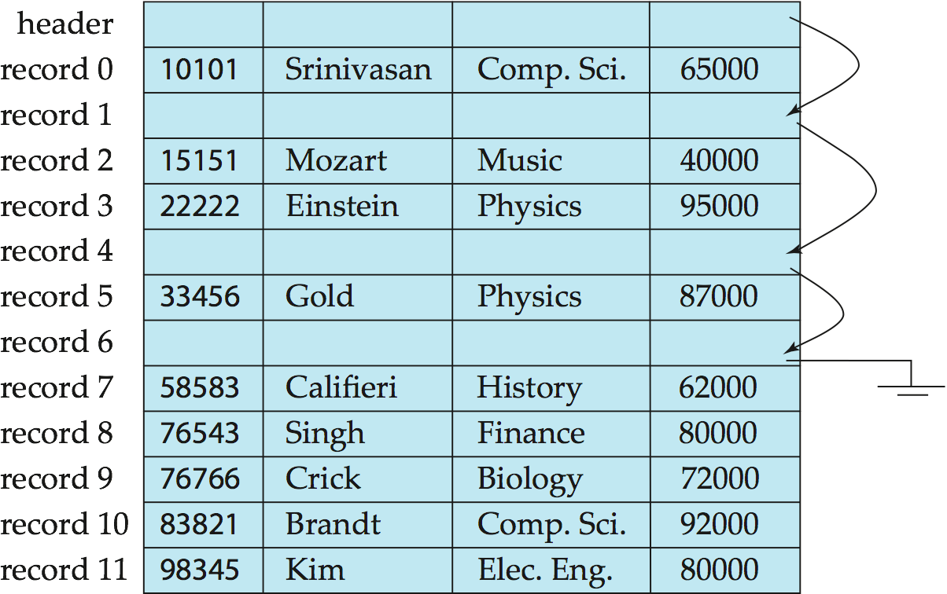
Free Lists
Store the address of the first deleted record in the file header.
Use this first record to store the address of the second deleted record, and so on
Can think of these stored addresses as pointers since they “point” to the location of a record.
More space efficient representation: reuse space for normal attributes of free records to store pointers. (No pointers stored in in-use records.)
all records are stored in a noncontiguous space

Slide 11
Variable-Length Records
Variable-length records arise in database systems in several ways
record types that allow variable lengths for one or more fields such as strings (varchar)
storage of multiple record types in a file, e.g. Multitable Clustering File Organization in 13.6.2
record types that allow repeating fields, e.g. multi-set, multi-value attribute (used in some older data models).
E.g. type account-list = record
branch-name: char(22)
account-info: array[1.. ∞] of
record
account-number : char(10)
balance : real
end
end

Slide 12
How to store variable-length records in block
Attributes in the record are stored in order
fixed length attributes at first, and then the variable-length attributes
Variable length attributes represented by fixed size (offset, length), with actual data stored after all fixed length attributes
Null values represented by null-value bitmap
表示本行某个属性是否取值为null

Slide 13
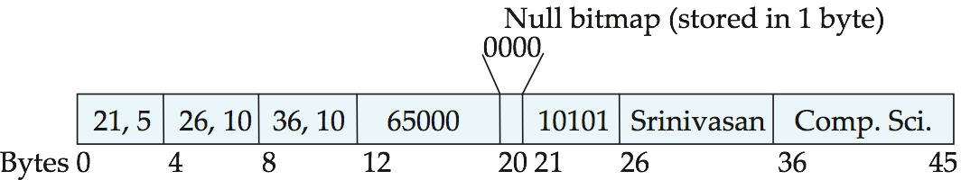
Variable length attributes represented by fixed size (offset, length), with actual data stored after all fixed length attributes
Null values represented by null-value bitmap
The slotted page (e.g. SQL Server2005/… later version) structure is often used to organize variable-length records
instructor: ID(varch) name(varch) dept(varch) salary(int)
<offset, length>
indicating which attributes of the record has null value
ID
name
dept
salary
Fig. record 0 is stored in contiguous 46 bytes (0-45)

Slide 14
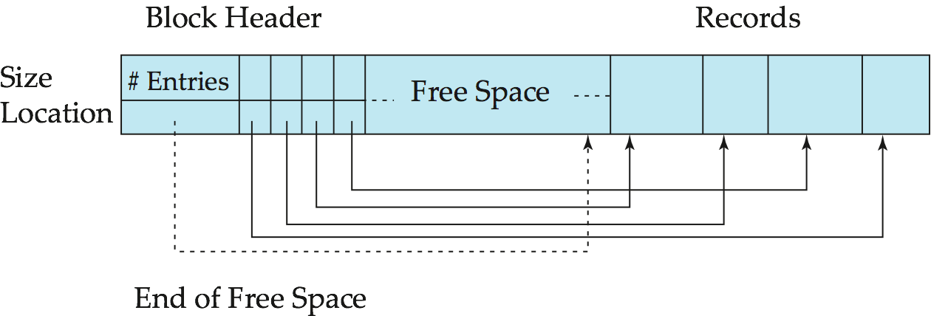
Variable-Length Records: Slotted Page Structure
The storage space is divided into fixed-sized slotted pages, e.g. 4KB or 8KB, and records are allocated to slotted pages, e.g. MS SQL Server
r_{i+3}
r_{i+2}
r_{i+1}
r_{i}
Fig. record_{i} to record_{i+3} in a page
Slotted page header contains
number of record entries, e.g. 4
end of free space in the block
location and size of each record

Slide 15
Records can be moved around within a page to keep them contiguous with no empty space between them
e.g. r_{i} is deleted, and r_{i+3}, r_{i+2} , r_{i+1} are moved to occupied the free space created by deletion
entry in the header must be updated, e.g. set to -1
Pointers should not point directly to record — instead they should point to the entry for the record in header
e.g. the pointer to r_{i}
move
r_{i+3}
r_{i+2}
r_{i+1}
r_{i}
deleted

Slide 16
13.3 Organization of Records in Files
/* 文件包括多个记录，这些记录在磁盘上的存放属于文件（记录）结构问题，即纪录的组织结构
/*对于某种结构的文件如何去查找、插入、删除记录，属于文件的存取方法
/*文件记录的组织结构决定了文件的存取方法
At the logical file level, from viewpoints of users, DB file can be viewed as a set of records, these records are logically organized in one of the following ways
heap, sequential, hash, clustering
logical organization of records also determine for file users how to access the records, i.e. access methods

Slide 17
Organization of Records in Files
Heap – a record can be placed anywhere in the file where there is space
e.g. data in a table that has no primary/unique keys and no index, student(ID, name, total-credits)
Sequential – store records in sequential order, based on the value of the search key of each record
e.g. student(ID, name, total-credits),
or student(ID, name, total-credits) with an index on name
Records of each relation may be stored in a separate file. In a multitable clustering file organization records of several different relations can be stored in the same file
motivation: store related records on the same block to minimize I/O,
e.g. for instructor join department, a record of instructor and a record of department are placed together in a file

Slide 18
Organization of Records in Files
B+-tree file organization
Ordered storage even with inserts/deletes
More on this in Chapter 14
Hashing – a hash function computed on some attribute of each record; the result specifies in which block of the file the record should be placed, refer to Ch.14

Slide 19
Heap File Organization
Any record can be placed anywhere in the file where there is space for the record
There is no ordering of records
Records usually do not move once allocated
Typically, there is a single file for a relation
/* 一般以纪录的输入顺序为序，决定了文件中记录顺序
/*纪录的存储顺序与记录中的主键无关
E.g. 创建新关系表student(ID, name, total-credits)，但不在student上定义主键、候选键、各类索引，student被组织为heap file
通过insert，将记录/元组加到堆文件中

Slide 20
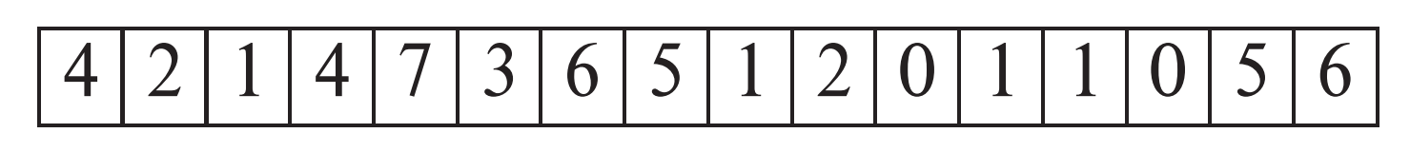
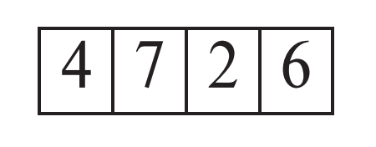
Heap File Organization
Important to be able to efficiently find free space within file
Free-space map
array with 1 entry per block. Each entry is a few bits to a byte, and records fraction of block that is free
In example below, 3 bits per block, value divided by 8 indicates fraction of block that is free
Can have second-level free-space map
In example below, each entry stores maximum from 4 entries of first-level free-space map
Free space map written to disk periodically, OK to have wrong (old) values for some entries (will be detected and fixed)

Slide 21
Sequential File Organization
Records are logically ordered by search-keys, that is, records are stored in sequential order, based on the value of the search key of each record
it is desirable that the records are also physically stored in search-key order, or as close to search-key order as possible
to minimize the number of block accesses in sequential processing
Chain together records by pointers, and the pointer in each record points to the next record in search-key order
From viewpoints of DB, sequential access to the file
Need to reorganize the file from time to time to restore sequential order

Slide 22
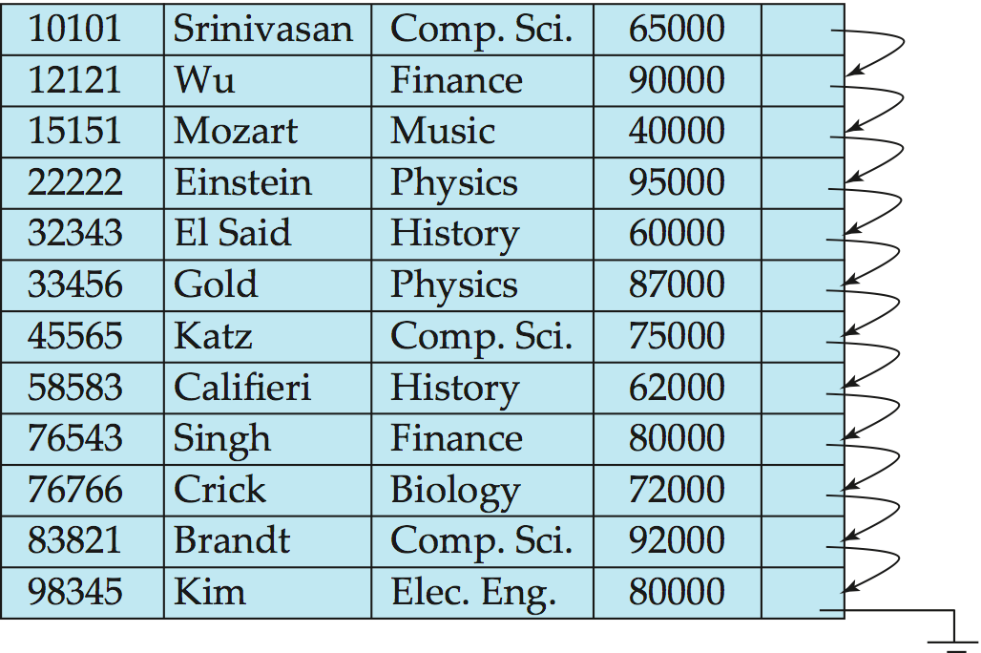
Sequential File Organization
Suitable for applications that require sequential processing of the entire file
The records in the file are ordered by a search-key
ID
records may be stored in a noncontiguous space

Slide 23
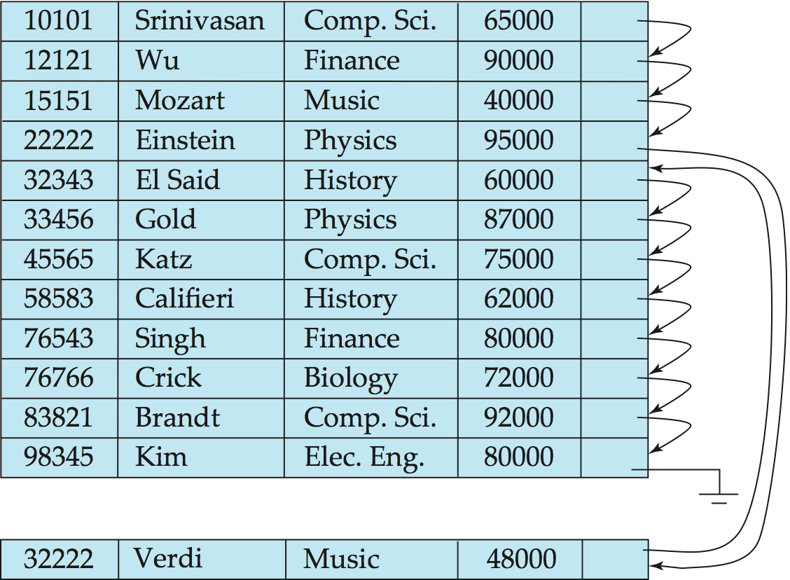
Sequential File Organization
Deletion – use pointer chains
Insertion –locate the position where the record is to be inserted
if there is free space insert there
if no free space, insert the record in an overflow block
In either case, pointer chain must be updated
Need to reorganize the file from time to time to restore sequential order

Slide 24
Clustering File Organization
//一个DB文件可以存储来自多个关系的纪录。不同关系中有联系的纪录存放在同一block中，以提高查找和I/O速度
Store several relations in one file using a multitable clustering file organization, i.e. records of several different relations are stored in the same file
motivation: store related records on the same block to minimize I/O

Slide 25
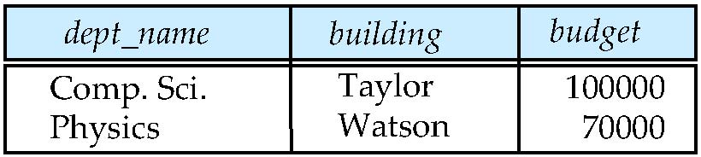
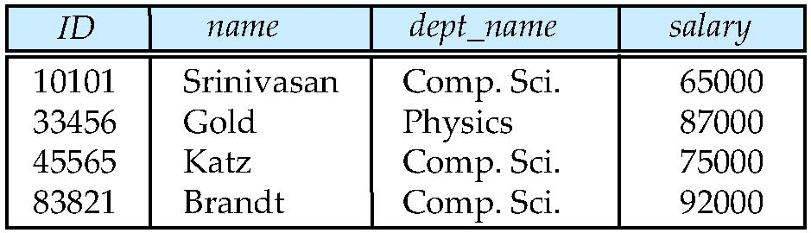
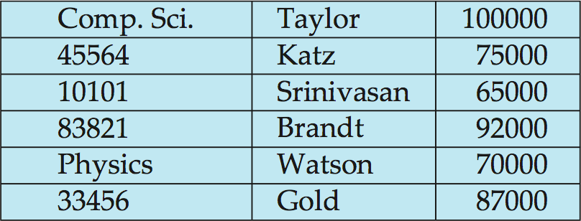
Multitable Clustering File Organization
一个DB文件存储来自多个关系的纪录。不同关系中有联系的纪录存放在同一block中，以提高查找和I/O速度
department
instructor
multitable clustering
of department and
instructor

Slide 26
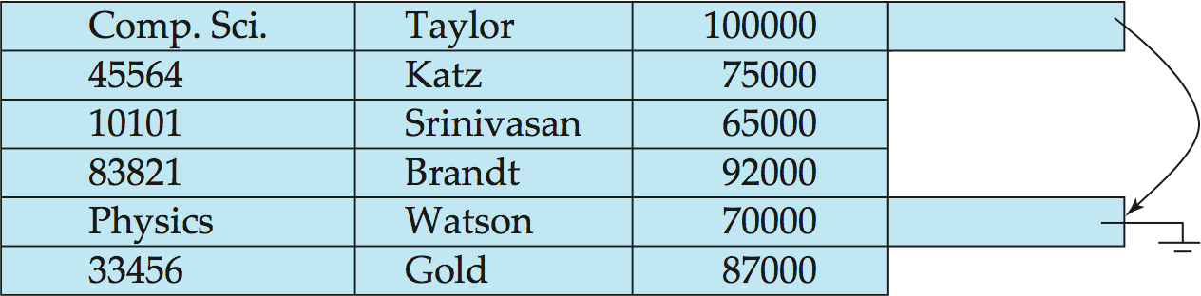
Multitable Clustering File Organization
Good for queries involving department instructor, and for queries involving one single department and its instructors
物化视图
bad for queries involving only department
results in variable size records
Can add pointer chains to link records of a particular relation

Slide 27
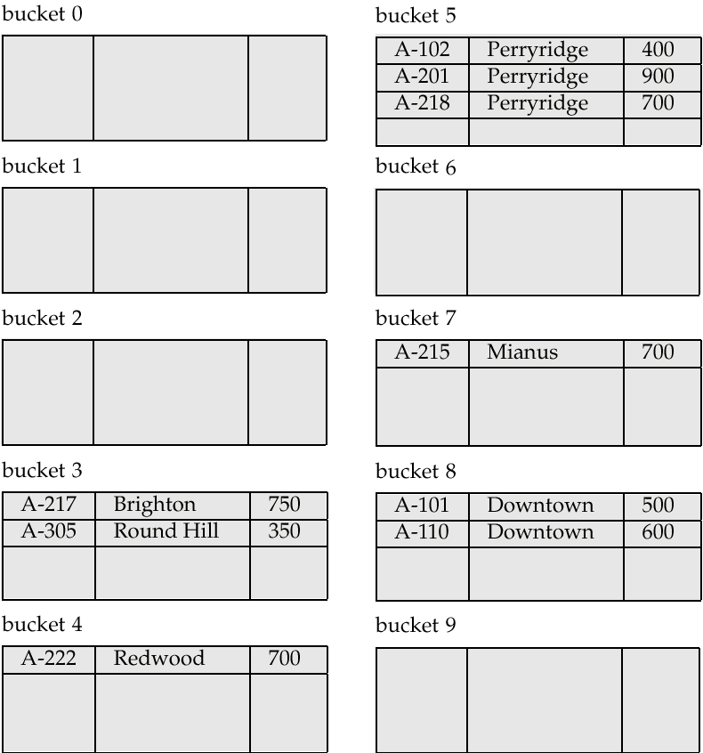
Hashing File Organization
The file records are stored in a number of buckets, the #bucket is the address of the record
A hash function on some attributes of file records (i.e. search key) is used to determine the addresses of the records in the file
Hash function
h : {search key} → {physical address of the records}, i.e. #bucket
the result of the function specifies in which block/bucket of the file the record should be placed
Hash file organization of account(ID, branch-name,balance) file,
using branch-name as the search key

Slide 28
Partitioning
Table partitioning
records in a relation can be partitioned into smaller relations that are stored separately
分库分表
E.g., transaction relation may be partitioned into transaction_2018, transaction_2019, etc.
Queries written on transaction must access records in all partitions
Unless query has a selection such as year=2019, in which case only one partition in needed
Partitioning
Reduces costs of some operations such as free space management
Allows different partitions to be stored on different storage devices
E.g., transaction partition for current year on SSD, for older years on magnetic disk

Slide 29
13.4 Data Dictionary Storage 【20211122】
Data dictionary (also called system catalog) stores metadata; that is, data about data, such as
Information about relations
names of relations
names, types and lengths of attributes of each relation
names and definitions of views
integrity constraints
User and accounting information, including passwords
Statistical and descriptive data
number of tuples in each relation
Physical file organization information
How relation is stored (sequential/hash/…)
Physical location of relation
Information about indices (Chapter 14)

Slide 30
Relational Representation of System Metadata
Relational representation on disk
Specialized data structures designed for efficient access, in memory

Slide 31
13.5 Data Buffer
A database file is partitioned into fixed-length storage units called blocks. Blocks are units of both storage allocation and data transfer.
Database system seeks to minimize the number of block transfers between the disk and memory. We can reduce the number of disk accesses by keeping as many blocks as possible in main memory.
Buffer – portion of main memory available to store copies of disk blocks
Buffer manager – subsystem responsible for allocating buffer space in main memory
e.g. in MS SQL Server, the buffer size is an adjustable parameter that has impact on the system performance, e.g. throughput

Slide 32
Transaction
data accesses on data item x and y issued by T_{i},
e.g. select, insert, delete, update, …
DBMS
x_{i}, y_{i}
local buffer for T_{i}
逻辑读写
read(x)
write(y)
P_{X}:
the page in buffer,
containing X
P_{X}
P_{Y}
…
P_{Z}
disk buffer
物理读写
input(X)
output(Y) / reflect
DB file on disk
B_{X}
B_{Y}
…
B_{Z}
B_{W}
B_{U}
B_{V}
…
B_{Q}
B_{R}
Fig.13.0.3 read and write operations

Slide 33
Buffer Management
Programs call on the buffer manager when they need a block from disk
1. if the block is already in the buffer, buffer manager returns the address of the block in main memory
2. if the block is not in the buffer, the buffer manager
1. allocates space in the buffer for the block
Replacing (throwing out) some other block, if required, to make space for the new block.
Replaced block written back to disk only if it was modified since the most recent time that it was written to/fetched from the disk.
2. reads the block from the disk to the buffer, and returns the address of the block in main memory to requester.

Slide 34
Buffer Manager
Buffer replacement strategy (details coming up!)
Pinned block: memory block that is not allowed to be written back to disk
pin done before reading/writing data from a block
unpin done when read /write is complete
multiple concurrent pin/unpin operations possible
Keep a pin count, buffer block can be evicted only if pin count = 0
Shared and exclusive locks on buffer, Latch锁
//buffer作为reader-writer problem中的shared data，施加 shared lock, exclusive lock
Needed to prevent concurrent operations from reading page contents as they are moved/reorganized, and to ensure only one move/reorganize at a time
Readers get shared lock, updates to a block require exclusive lock
Locking rules:
Only one process can get exclusive lock at a time
Shared lock cannot be concurrently with exclusive lock
Multiple processes may be given shared lock concurrently

Slide 35
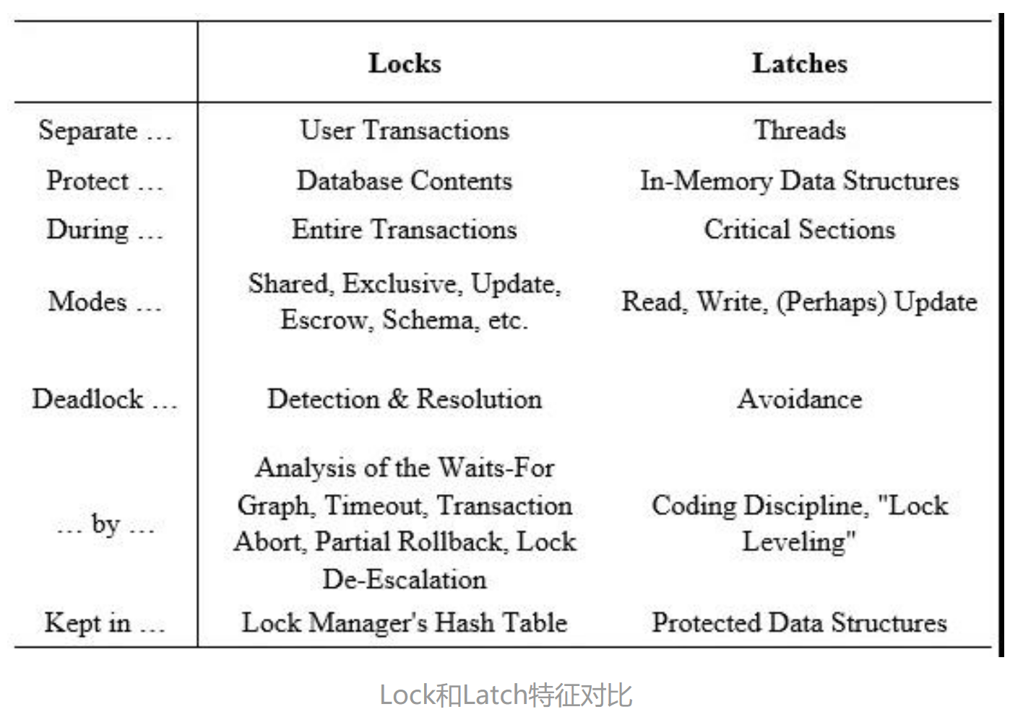
DBS中两种锁机制：Lock, Latch
保护数据一致性，不被并发访问破坏
Lock
保护数据库逻辑内容，对整个事务加锁，持续时间长；支持事务回滚，以及事务对数据的修改
Locking on concurrent transactions
Latch
保护内存中特定共享数据结构不会应并发访问而被破坏
Latching on shared data structures in memory，e.g. on the dirty page in buffer

Slide 36
Buffer-Replacement Policies
Most operating systems replace the block least recently used (LRU strategy)
// refer to page replacement in Operating System Concepts, for more detail
Idea behind LRU – use past pattern of block references as a predictor of future references
LRU can be bad for some queries
Queries have well-defined access patterns (such as sequential scans), and a database system can use the information in a user’s query to predict future references
Mixed strategy with hints on replacement strategy provided by the query optimizer is preferable
Example of bad access pattern for LRU: when computing the join of 2 relations r and s by a nested loops
for each tuple tr of r do for each tuple ts of s do if the tuples tr and ts match …

Slide 37
Buffer-Replacement Policies ( 略)
Toss-immediate strategy – frees the space occupied by a block as soon as the final tuple of that block has been processed
Most recently used (MRU) strategy – system must pin the block currently being processed. After the final tuple of that block has been processed, the block is unpinned, and it becomes the most recently used block.
Buffer manager can use statistical information regarding the probability that a request will reference a particular relation
E.g., the data dictionary is frequently accessed.
Heuristic: keep data-dictionary blocks in main memory buffer
Operating system or buffer manager may reorder writes
Can lead to corruption of data structures on disk
E.g., linked list of blocks with missing block on disk
File systems perform consistency check to detect such situations
Careful ordering of writes can avoid many such problems

Slide 38
Optimization of Disk Block Access
Buffer managers support forced output of blocks for the purpose of recovery (more in Chapter 19)
Nonvolatile write buffers speed up disk writes by writing blocks to a non-volatile RAM or flash buffer immediately
Writes can be reordered to minimize disk arm movement
Log disk – a disk devoted to writing a sequential log of block updates
Used exactly like nonvolatile RAM
Write to log disk is very fast since no seeks are required
Journaling file systems write data in-order to NV-RAM or log disk
Reordering without journaling: risk of corruption of file system data

Slide 39
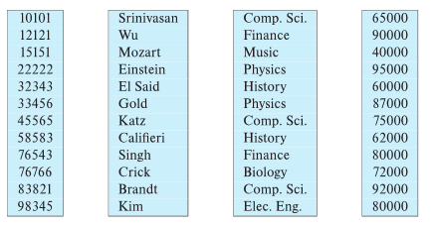
13.6 Column-Oriented Storage
Also known as columnar representation
Store each attribute of a relation separately
Example
instructor(ID, Name, depart-name, salary)
update instructor
set salary=salary + 100
where ID=15151

Slide 40
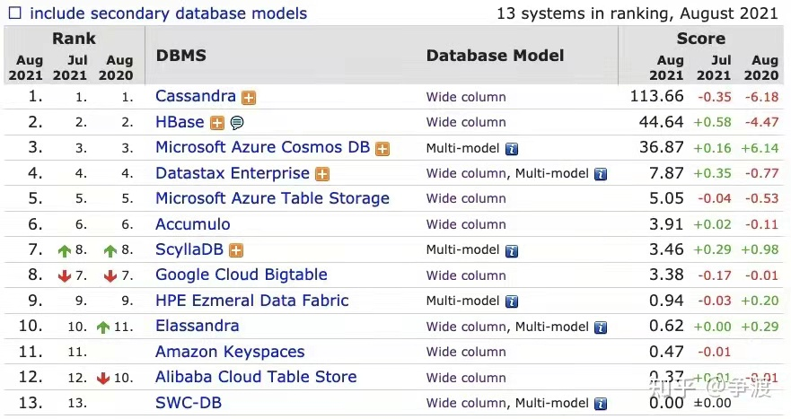
Column-storage Database

Slide 41
Columnar Representation
Benefits:
Reduced IO if only some attributes are accessed
Improved CPU cache performance
Improved compression
Vector processing on modern CPU architectures
Drawbacks
Cost of tuple reconstruction from columnar representation
Cost of tuple deletion and update
Cost of decompression
Columnar representation found to be more efficient for decision support than row-oriented representation
Traditional row-oriented representation preferable for transaction processing
Some databases support both representations
Called hybrid row/column stores
update instructor
set salary=salary + 100
where ID=15151

Slide 42
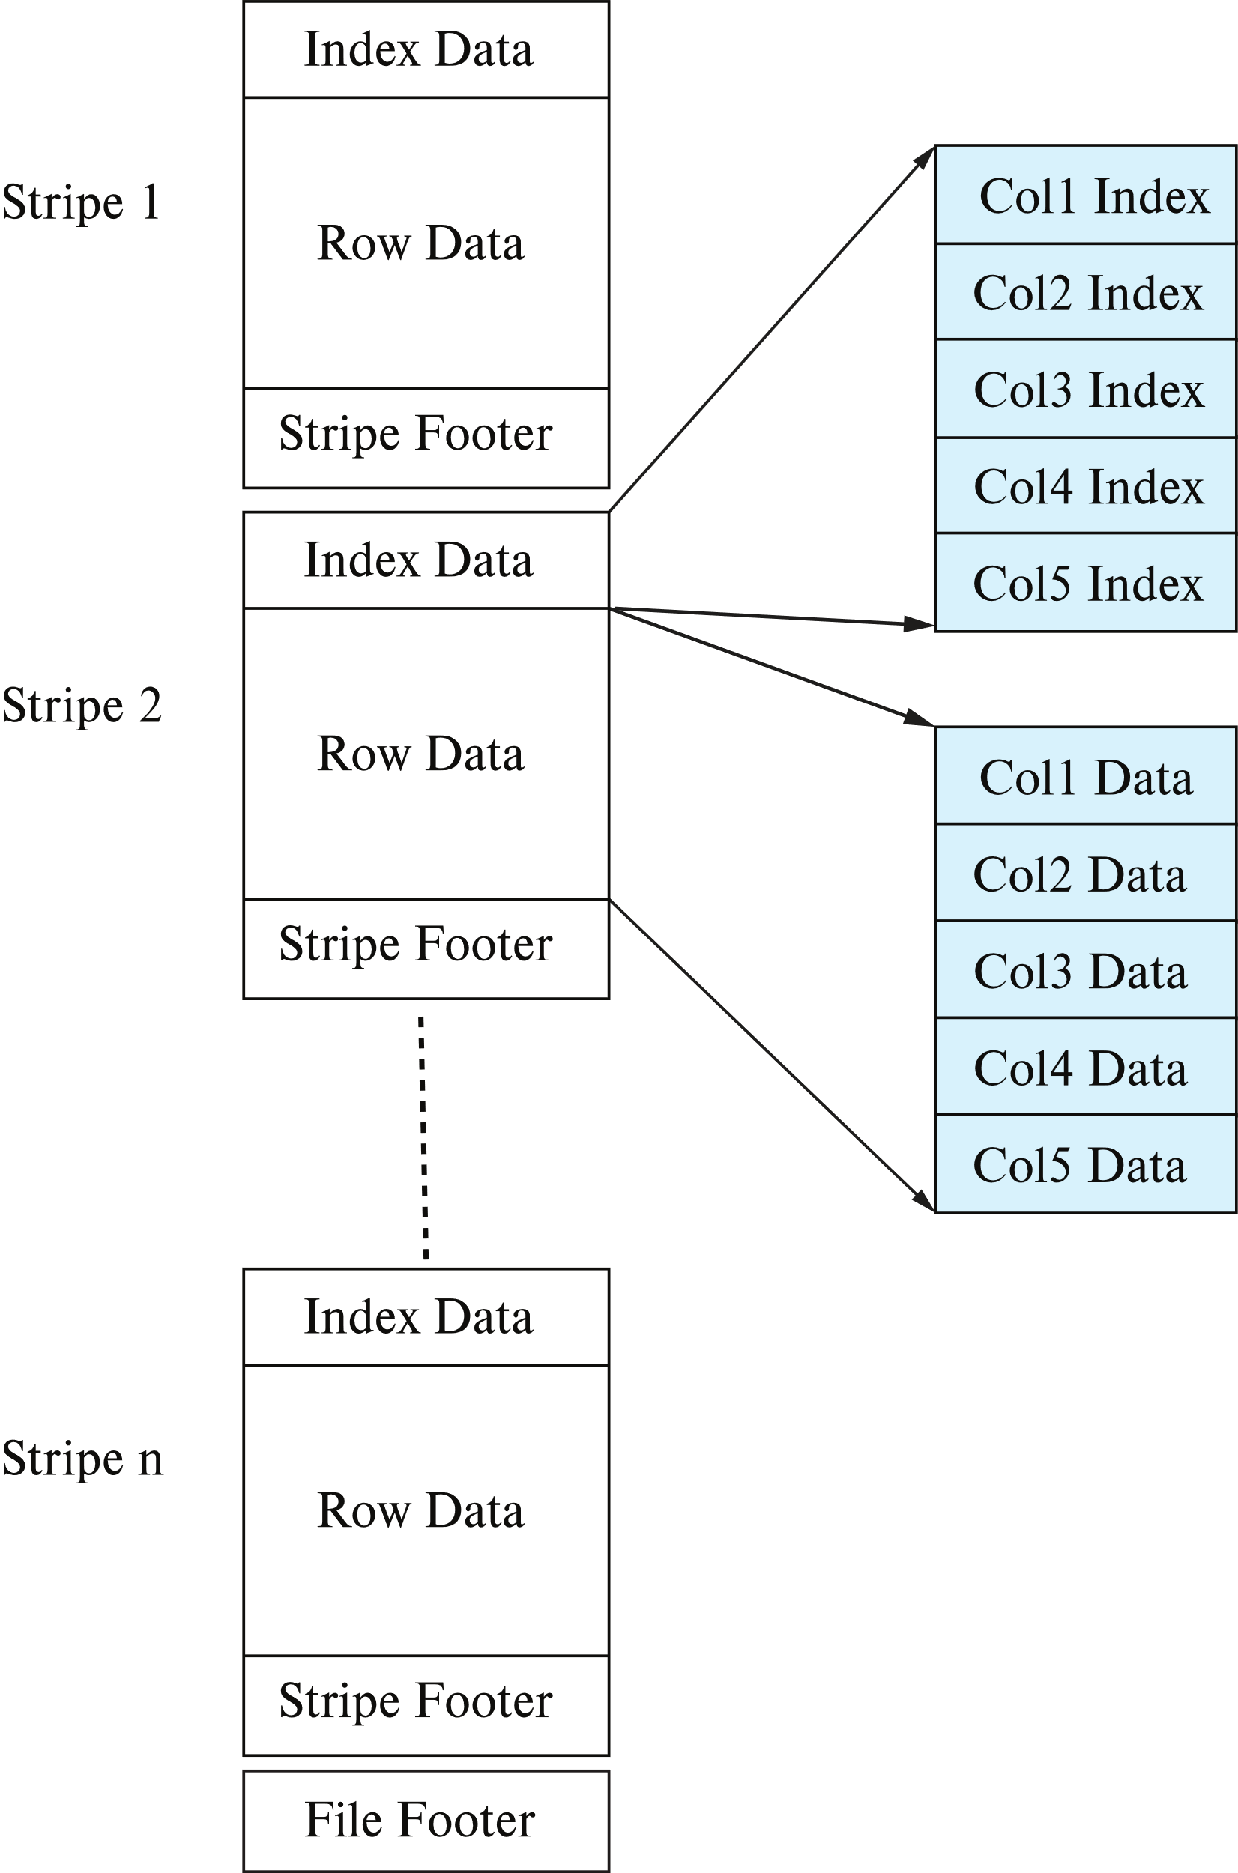
Columnar File Representation
ORC and Parquet: file formats with columnar storage inside file
Very popular for big-data applications
Orc file format shown on right:

Slide 43
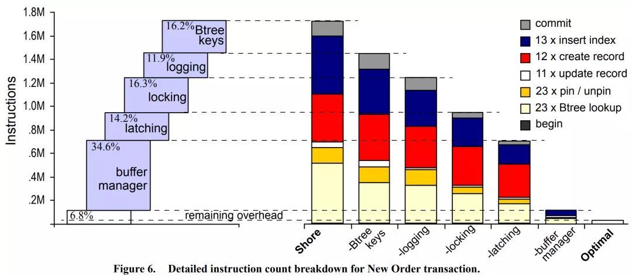
13.7 Storage Organization in Main-Memory Databases
面向磁盘的数据库性能开销分析（2008年，SIGMOD论文）
假设一次业务处理（如SQL 查询）的总开销是100%，其中
7%不到，真正处理业务逻辑
34%，用于缓冲区管理如缓冲区的加载替换、地址转化等
14%，处理对于内存数据结构互斥访问加锁Latching
16%，处理事务并发访问时，事务处理加锁Locking
12%，处理日志Logging
16%，用于对B树索引的处理

Slide 44
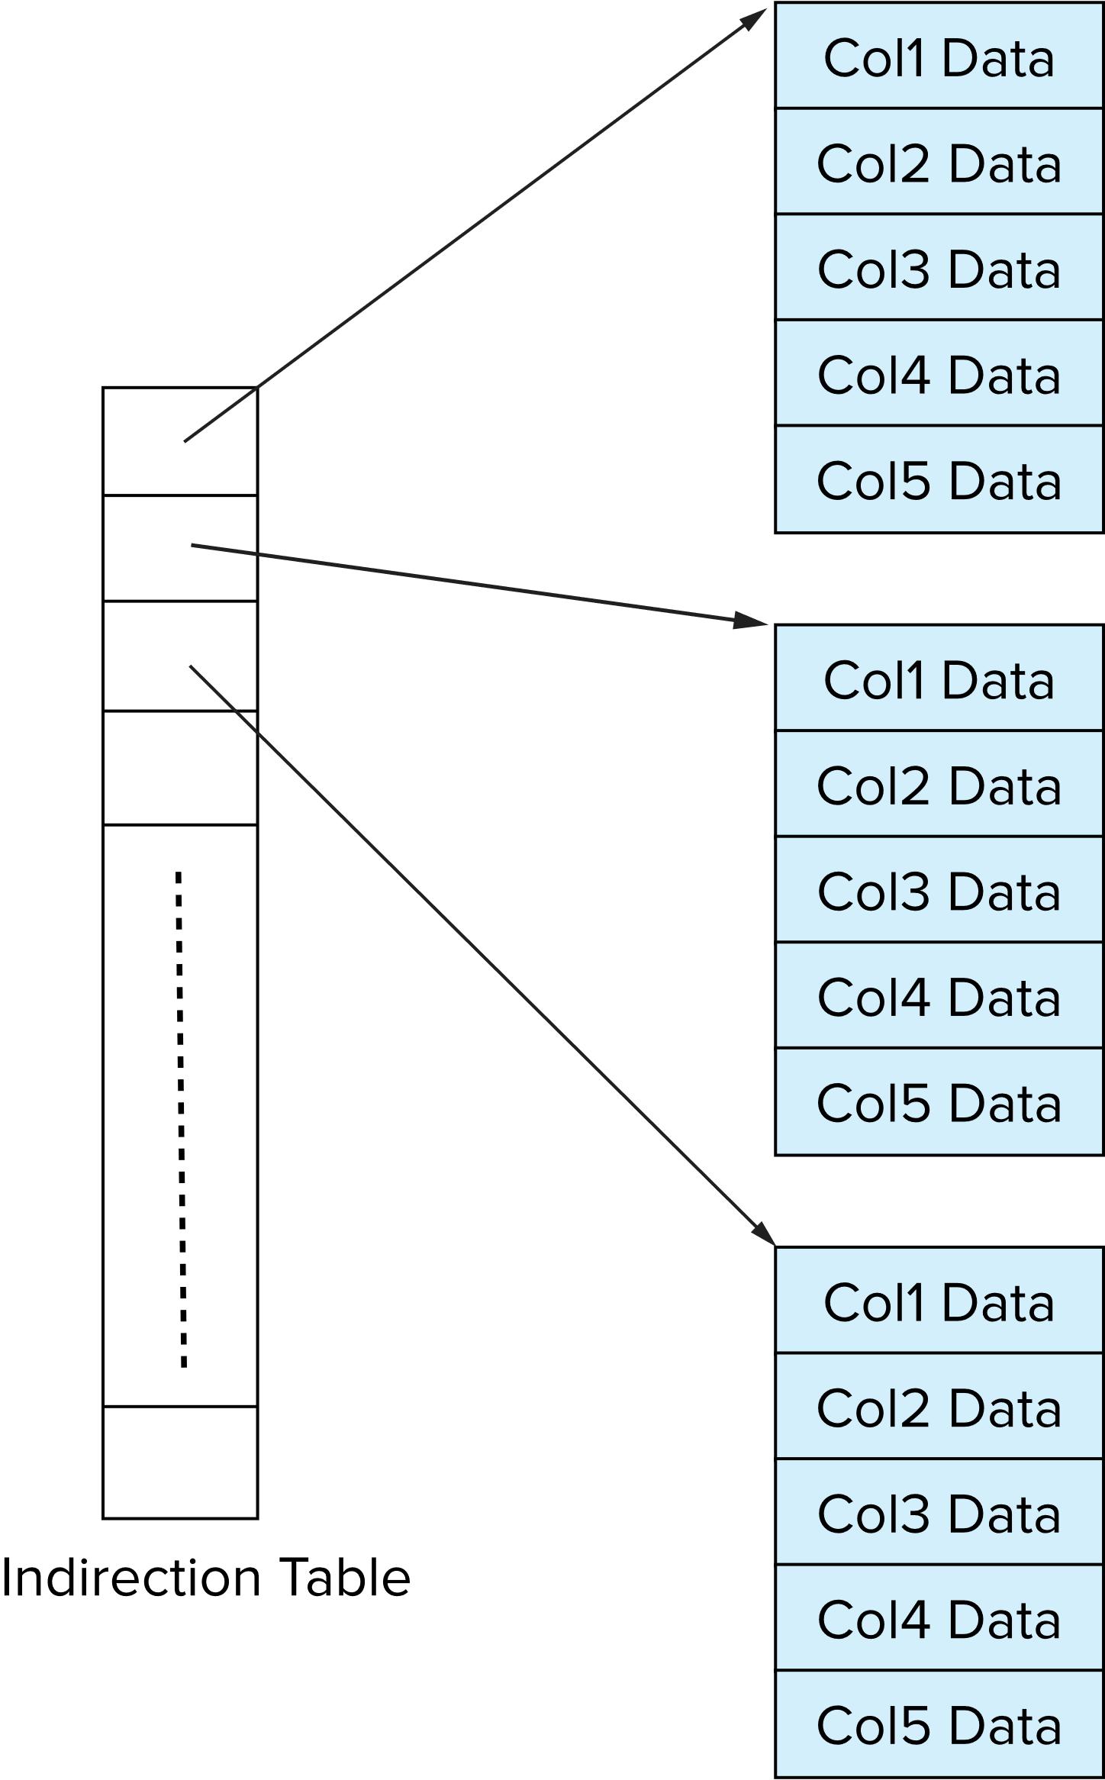
Storage Organization in Main-Memory Databases
内存数据库(in-memory database)
Can store records directly in memory without a buffer manager
Column-oriented storage can be used in-memory for decision support applications
Compression reduces memory requirement

Slide 45
Storage Organization in Main-Memory Databases
参考资料
内存数据库解析与主流产品对比（一） - 知乎
https://zhuanlan.zhihu.com/p/234919129
内存数据库解析与主流产品对比（二） - 知乎
https://zhuanlan.zhihu.com/p/266220990
主流关系型内存数据库
MySQL memory storage engine
SQL Server in-Memory OLTP，SQL Server Hekaton
Oracle Times Ten
H-Store/VoltDB, by Michael Stonebraker

Slide 46
Appendix 13-1 Data Organization and Access in DBS
Data organization in DBS
Data access in DBS
in small DBS
in medium or large scale DBS

Slide 47
Data Organization in DBS
DBS provides the services of data organization and access for DBS user
From viewpoints of DBS users, data is organized as
relational tables, tuples, and attributes
user-oriented logical organization of data
From viewpoints of operating systems, data is stored as OS file, also known as DB file
DB file is logically organized as a sequence of records
DB file resides on secondary storages, i.e. disks, in unit of block

Slide 48
Data Organization in DBS
DBS数据的基本逻辑单位—元组/数据行与OS文件中数据的基本逻辑单位—文件记录的对应关系
1个元组对应于文件系统的1个逻辑记录
fixed-length record
variable-length record
1个关系表对应于1个OS文件，或1个文件存储多个关系表的数据
record与磁盘基本存储单位—block的对应关系关系
in DBS, 1个block包含多个文件逻辑记录

Slide 49
Data Access in DBS
在一些小型关系数据库系统（如dbase、Foxbase）中，关系表被存储在单独的文件中，DBMS利用OS文件系统作为其DBMS物理层实现基础，利用OS文件系统实现数据组织与访问
操作系统为DB分配所需的磁盘block
有可能将逻辑上相邻的数据分配到磁盘上不同的区域，导致连续访问时效率下降
用户对DB文件数据的访问需要借助于OS文件系统提供的文件结构和存取路径
DBMS对OS依赖太大，不利于数据库系统的移植
DBS数据访问过程中，DBMS的storage management （Fig.1.4) 、OS文件系统、I/O子系统完成如下地址变换
DB关系表中元组/数据行 到 DB文件中数据的逻辑地址（文件名，记录号）间的映射
DB文件记录号到外设上数据物理地址（记录所在的物理块号和具体地址）的映射

Slide 50
DBMS
OS file subsystem and I/O subsystem
relational table
OS logical file
secondary storage,
e.g. disk
tables
/ tuples
/attributes
logical address
: #record, or index
physical address
: platter/cylinder
/track/sector
block_{1i}
record₁
block_{2i}
tuple₁
record₂
block₁
tuple₂
record₃
block_{3i}
tuple₃
DB
user
record
block
…
…
…
tuple_{m-1}
record_{n-1}
block_{k-1,i}
tuple_{m}
record_{n}
Block_{k,i}
Relations, tuples, and
attributes in DBS
DB file in secondary storage
Fig.A.1 Data Access in DBS-I

Slide 51
Data Access in DBS
一些现代大型关系数据库系统，如SQL Server、Oracle等，为了适应数据的动态变化、提供数据快速访问路径，DB数据仍然以DB文件的方式存在，但对DB文件的管理并不直接依赖于OS文件系统
在创建数据库时，DBMS向OS一次性申请所需磁盘空间，在此磁盘存储空间中，DBMS独立地为数据库中的数据设计存储和访问结构
分配管理DB文件，提供数据访问机制
SQL Server as Case Study
Fig.A.3, Fig.A.4, Fig.A.5
借鉴了操作系统虚拟内存管理技术中page/frame的思想

Slide 52
Data Access in DBS
SQL Server中，一个用户数据库由用于存储表(table)和索引(index)的磁盘存储空间构成，这些空间被分配在一个或多个操作系统文件上
数据库被划分许多逻辑页(page)，每个逻辑页大小为8KB
每个数据库文件由多个从0开始连续编号的页组成。 每个页逻辑上划分为许多从1开始连续编号的槽(slot)，每个槽用于存放一个数据库表中的数据行/元组/纪录
页头：96字节
槽1
…
槽n
行偏移组
Fig. A.3 Page in SQL Server

Slide 53
Data Access in DBS
对于1个DB表中的数据行/元组/纪录，SQL Server用该表所在的数据库文件ID、数据行所在页ID和槽ID来标识
数据行的逻辑地址： <文件ID, 页ID, 槽ID>
SQL Server以盘区为单位，为DB文件的页分配磁盘上的物理存储空间
盘区大小为64K，占用8个连续的页
DB文件中数据行/元组/纪录物理地址：数据行所在盘区的物理地址，如block#
SQL Server利用全局分配映象GAM和共享全局分配映象S GAM 这2个数据结构纪录每个盘区的使用情况
是否空闲、是否共享

Slide 54
Data Access in DBS
SQL Server利用索引分配映象IAM数据结构纪录每个数据库文件的页与该页所在物理盘区间的对应关系
SQL Server利用索引实现对关系表中的数据行/元组的访问
Index: search key → <文件ID, 页ID, 槽ID>
SQL Server可对关系表的主键自动建立索引
SQL Server数据存储与访问机制
Fig. A.4
2级地址映射
基于索引的search key → 逻辑地址：<文件ID, 页ID, 槽ID>
基于IAM的数据行逻辑地址→数据行物理地址（盘区物理地址）

Slide 55
DBMS
relational table
secondary storage,
e.g. disk
tables
/ tuples
/attributes
logical address
: #file, #page, #slot
physical address
: #盘区
page₁
盘区_{1,i}
tuple₁
page₂
盘区_{2, i}
tuple₂
page₃
tuple₃
Index
IAM
DB
user
…
…
…
盘区_{k-1, i}
tuple_{m-1}
page_{n-1}
tuple_{m}
page_{n}
盘区_{k, i}
Relations, tuples, and
attributes in DBS
DB file in secondary storage
Fig.A.4 Data Access in SQL Server

Slide 56
Appendix 13-2 Files Organization in Oracle and OpenGauss
来源：openGuass微信公众号
openGauss能兼容Oracle的数据库表吗？1
Oracle数据库中7种数据库表
堆表，索引组织表，簇表
对应于教科书：heap, sequential, clustering
临时表，表压缩，分区表，嵌套表
堆表
Oracle和openGauss默认表类型
在数据写入时无需考虑行存放的顺序（按照写入的时间先后顺序存放），因此写入速度较高，但由于是无序存放，读取效率较低

Slide 57
Files Organization in Oracle and OpenGauss
索引组织表
以索引的方式保存表的数据，表中数据根据主键顺序进行存储排列，提高了访问的速度
缺点
索引块保存所有的字段的信息，需要更多的叶子页面保存数据，数据量较大的时候会造成访问效率降低
如果主键频繁修改，对应的行也就需要磁盘位置频繁修改，行需要在不同的块之间相互移动
使用索引组织表
表的宽度（即一行的数据长度）有限
表的主键不会或极少更改
表主要用于查询，DML操作较少
大部分的业务需求是根据主键查询行中其它列上的信息

Slide 58
Files Organization in Oracle and OpenGauss
索引组织表（续）
openGauss目前版本不支持索引组织表？？，对于应用程序来说，索引组织表的使用方式与堆表并无差异
簇表
簇表也称为Cluster，在没有数据表和索引的时候，Cluster段是可以单独存在的
依据一定的规则，如连接键（Join Key），可以将多个数据表数据保存在同一个段中。并且依据一定场景实现快速检索连接
在openGauss中，无法兼容此功能

Slide 59
Files Organization in Oracle and OpenGauss
临时表
一种特殊类型的表，用来保存临时数据的一个数据库对象
只能存储在临时表空间，而非用户的表空间，对临时表的DML操作通常不记录事务日志
Oracle临时表分为事务级临时表和会话级临时表
事务级临时表的数据只保存在事务的生命周期中
会话级临时表能支持会话的完整生命周期
这两种级别的临时表，openGauss都可以支持
表压缩
对表数据进行压缩，达到节省空间的目的
压缩对于数据装载和DML操作有一定的CPU消耗
Oracle常用的压缩方式有两种
基础压缩，OLTP压缩

Slide 60
Files Organization in Oracle and OpenGauss
分区表
将一个大表按照一定的规则分解成多张具有独立存储空间的实体表。对于应用来说，逻辑上只有一个表，但在物理上这个表由多个物理分区组成
每个分区都是一个独立的对象，可以独自处理，也可以作为一个更大对象的一部分进行处理
分为范围分区、列表分区、哈希分区，复合分区
范围分区
对数据表中的某个值的范围进行分区，根据某个值的范围，决定将该数据存储在哪个分区上
如根据序号分区，根据业务记录的创建日期进行分区
列表分区
根据所有可能的值，指定应该插入相应的分区

Slide 61
范围分区：
postgres=# CREATE TABLE t_range_partition
( prod_id NUMBER(6)
, cust_id NUMBER
, time_id DATE
, channel_id CHAR(1)
, promo_id NUMBER(6)
, quantity_sold NUMBER(3)
, amount_sold NUMBER(10,2)
) PARTITION BY RANGE (time_id)
(PARTITION sales_q1_2006 VALUES LESS THAN (TO_DATE('01-APR-2006','dd-MON-yyyy')) TABLESPACE pg_default,
PARTITION sales_q2_2006 VALUES LESS THAN (TO_DATE('01-JUL-2006','dd-MON-yyyy’)) TABLESPACE pg_default,
PARTITION sales_q3_2006 VALUES LESS THAN (TO_DATE('01-OCT-2006','dd-MON-yyyy'))TABLESPACE pg_default,
PARTITION sales_q4_2006 VALUES LESS THAN (TO_DATE('01-JAN-2007','dd-MON-yyyy')) TABLESPACEpg_default );
CREATE TABLE

Slide 62
列表分区：
postgres=# CREATE TABLE t_list_partition_table
(id number,
name varchar2(20),
sales number(10, 2),
state varchar2(2))
PARTITION BY LIST (state)
(PARTITION q1_northwest VALUES ('OR', 'WA'),
PARTITION q1_southwest VALUES ('AZ', 'UT', 'NM'),
PARTITION q1_northeast VALUES ('NY', 'VM', 'NJ'),
PARTITION q1_southeast VALUES ('FL', 'GA'),
PARTITION q1_northcentral VALUES ('SD', 'WI'),
PARTITION q1_southcentral VALUES ('OK', 'TX'));

Slide 63
Files Organization in Oracle and OpenGauss
散列（HASH）分区
在数据库表的各行的分区键值上执行一个hash散列函数，根据函数值决定各行数据的物理位置
散列分区将记录分布在比范围分区更多的分区上，减少了I/O争用的可能性
E.g.
postgres=# CREATE TABLE t_hash_partition
(deptno NUMBER, deptname VARCHAR(32))
PARTITION BY HASH(deptno)
(PARTITION p1 TABLESPACE pg_default, PARTITION p2 TABLESPACE pg_default,
PARTITION p3 TABLESPACE pg_default, PARTITION p4 TABLESPACE pg_default);

Slide 64
Files Organization in Oracle and OpenGauss
复合分区
先使用范围分区，然后在每个分区内再使用散列分区/列表分区
解决数据倾斜问题
postgres=# CREATE TABLE t_sub_partition
( dept_no number, country varchar2(20), sale_date date)
PARTITION BY RANGE(sale_date)
SUBPARTITION BY LIST(country)
( PARTITION q1_2012 VALUES LESS THAN('2012-Apr-01')
( SUBPARTITION q1_europe VALUES ('FRANCE', 'ITALY'),
SUBPARTITION q1_asia VALUES ('INDIA', 'PAKISTAN'),
SUBPARTITION q1_americas VALUES ('US', 'CANADA') ),
PARTITION q2_2012 VALUES LESS THAN('2012-Jul-01')
( SUBPARTITION q2_europe VALUES ('FRANCE', 'ITALY'),
SUBPARTITION q2_asia VALUES ('INDIA', 'PAKISTAN'),
SUBPARTITION q2_americas VALUES ('US', 'CANADA') ),
PARTITION q3_2012 VALUES LESS THAN('2012-Oct-01')
( SUBPARTITION q3_europe VALUES ('FRANCE', 'ITALY'),
SUBPARTITION q3_asia VALUES ('INDIA', 'PAKISTAN'),
SUBPARTITION q3_americas VALUES ('US', 'CANADA') ),
PARTITION q4_2012 VALUES LESS THAN('2013-Jan-01')
( SUBPARTITION q4_europe VALUES ('FRANCE', 'ITALY'),
SUBPARTITION q4_asia VALUES ('INDIA', 'PAKISTAN'),
SUBPARTITION q4_americas VALUES ('US', 'CANADA') ) )

Slide 65
Files Organization in Oracle and OpenGauss
嵌套表
类似C语言中的结构体，将一个表结构定义为一个类型，在创建其他表的时候，将字段类型指向这个自定义类型
postgres=# CREATE TYPE t_type AS (f1 int, f2 text);
CREATE TYPE
postgres=# CREATE TABLE t_compfoo(a int, b t_type);
CREATE TABLE

Slide 66
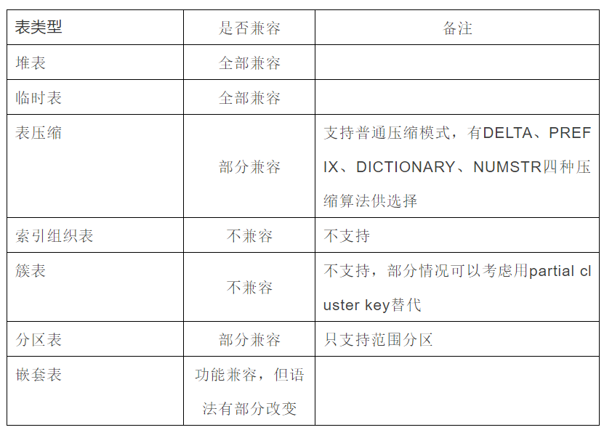
GaussDB对七种表类型的支持

Slide 67

Thanks for your attention

